Slide 1
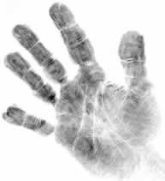
Dactyloscopy (fingerprint identification)
https://sites.google.com/site/magicofforensicscience/lesson2
28th August 2019

Slide 2
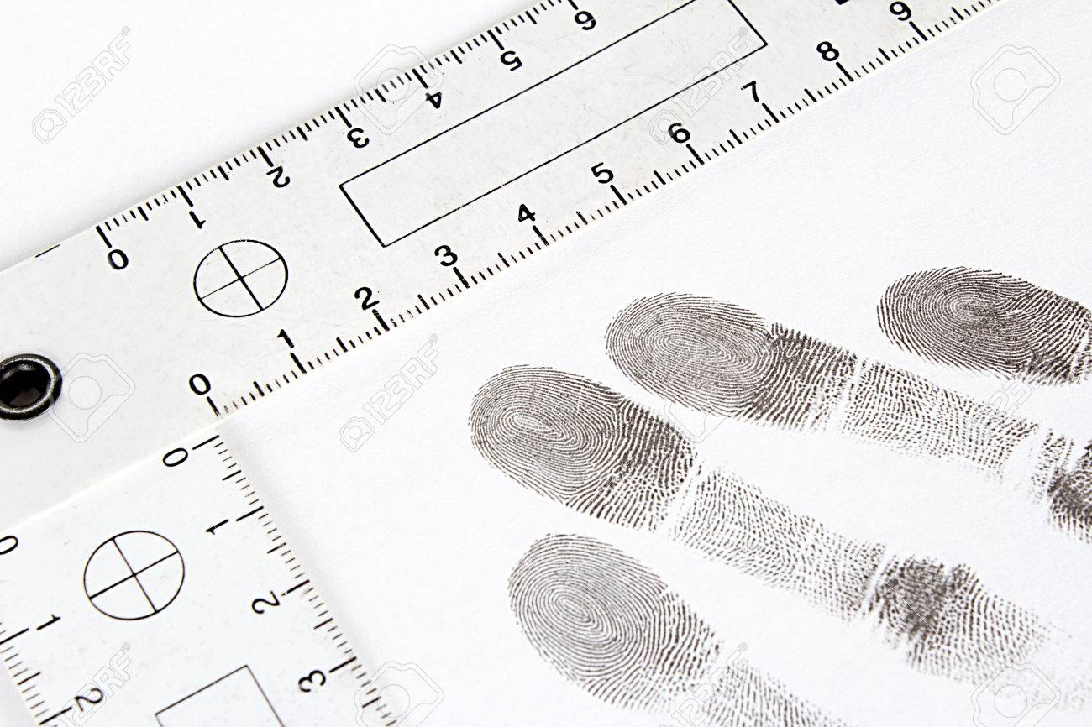
Dactyloscopy
Dactyloscopy (derived from the Greek word “daktylos” for “finger”) is the study that covers all aspects of detection, comparison, and identification of finger impressions.
This study actually covers all ridge skin impressions including those of palms and feet.
Fingermarks left by a criminal in a crime scene just confirms the Locard’s exchange principle.
https://www.123rf.com/photo_36355686_dactyloscopy-and-fingerprint-on-the-sheet-of-papper.html
Notes:
dactyloscopy
^{[ dak-tuh-los-kuh-pee ]}

Slide 3
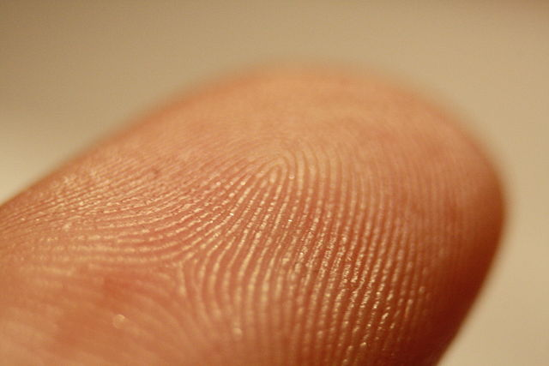
Invariable fingerprints
A friction ridge is a raised portion of the epidermis on the digits (fingers and toes), the palm of the hand or the sole of the foot, consisting of one or more connected ridge units of friction ridge skin.
The ridges on our fingers remain a unique identifier throughout our entire life.
The ridges on hands and feet of a fetus begins during the third month of pregnancy.
The physical conditions such as pressure on the different parts of the finger of the fetus in the uterus play a role in the development of the ridge structures, resulting in unique configurations of the ridges for every individual.
Even identical twins will have clearly distinguishable fingerprints.
Friction ridges on a fingerprint
By Frettie - Own work, CC BY 3.0, https://commons.wikimedia.org/w/index.php?curid=6158485
Notes:
Uterus มดลูก
Fetus ตัวอ่อน
Fingerprint once formed during the pregnancy, remain essential unchanged until after death.

Slide 4
Uniqueness-patterns and minutiae
There are 3 levels of information that can be distinguished in fingerprints.
The first level : the basic pattern of ridges composed of loops, whorls and arches.
The second level : the variation of sub-patterns called minutiae such as endings and bifurcations of the ridges.
The third levels : the shape and relative position of the pores in the ridges as well as the alignment and shape of each part of a ridge.
The first level information is used to screen possible suspects and subsequently a prime suspect is to be mostly confirmed by the second level information.
Notes:
A high quality traces in file prevent an effective usage of the third level information.
Loop มัดหวาย
Whorl ก้นหอย
Arch โค้ง

Slide 5
Broad Classification patterns : first level
Arch (ลายโค้ง)
Loop (ลายมัดหวาย)
Whorl (ลายก้นหอย)
Additional subclasses are simply variations of the three classes, eg : Plain arch, twinned loop etc.
Notes:
To screen only a few suspects from a number of suspects, the classification pattern recognition is applied.
To individually identify a suspect, the minutiae (ridge characteristics) recognition is applied.

Slide 6
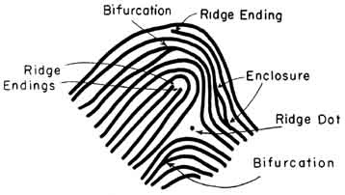
Minutiae (ridge characteristics)
เส้นหยุด
สะพาน
เส้นแยก
เส้นแยกสองชั้น
A ridge characteristic is a micro- element of the pattern of the print. That is, all classes of prints may contain any or all of the ridge characteristics.
There are three basic ridge characteristics that an expert will seek to detect and then match up against the reference or sample print:
• the ridge ending;
• the bifurcation; and
• the dot (or island).
จุด
สามง่าม
เส้นสั้น
เส้นแยกตรงข้าม
เกาะ
เส้นไขว้
ตะขอ
รัศมีสามแฉก
https://sites.google.com/site/magicofforensicscience/lesson2

Slide 7
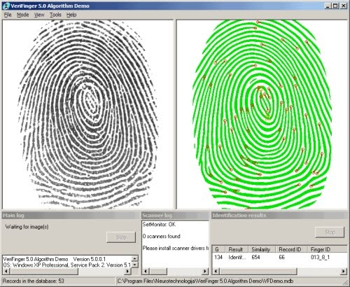
The identification standard
The matching of the sample print with the reference print is an expert science with national and international standards.
The identification standard refers to the minimum number of “minutiae” points that are able to be compared.
The matching is compared in terms of the minutiae positioning relative to others and the type of the minutiae characteristics.
The process of comparison of fingerprints by an expert can have only three outcomes : Match, Mismatch or Don’t know.
Fingerprints are collected by police officers and entered into an Automated Fingerprint Identification System (AFIS) for minutiae matching.
https://sites.google.com/site/magicofforensicscience/lesson2

Slide 8
Types of fingerprints
Types of fingerprints | details
Visible fingerprints | The fingerprints are left in some medium, like blood, that reveals them to the naked eye. They can be when blood, dirt, ink or grease on the finger come into contact with a smooth surface and leave a friction ridge impression that is visible without development.
Plastic fingerprints | The fingerprints are indentations left in soft pliable surfaces, such as clay, wax, paint or another surface that will take the impression. They are visible and can be viewed or photographed without development.
Latent fingerprints | They are formed from the sweat from sebaceous glands on the body or water, salt, amino acids and oils contained in sweat. The sweat and fluids create prints must be developed before they can be seen or photographed.
http://www.odec.ca/projects/2004/fren4j0/public_html/types_prints.htm

Slide 9
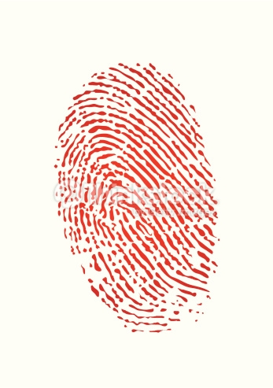
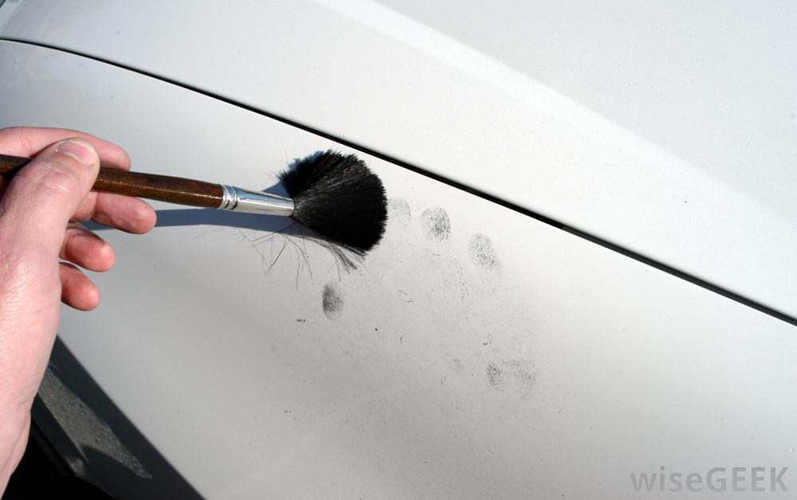
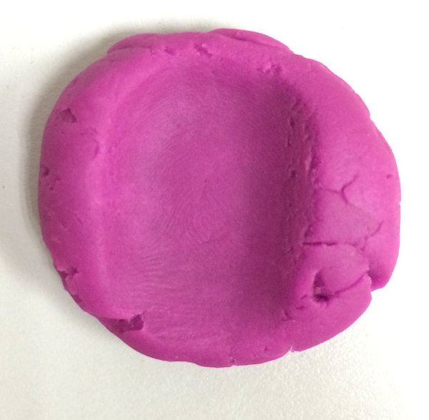
Type of fingerprints
Primary constituents of latent fingerprints
Water (> 98%)
Mineral salts
Amino acids
Fatty acids
Visible fingerprint
plastic fingerprint
latent fingerprint
https://h5p.org/node/27718

Slide 10
Detection of fingerprints : Oblique lighting
The diffused light form the deposits-as opposed to transmitted or specularly reflected light from the substrate- can let
a fingerprint stand out brightly against a dark background.

Slide 11
Fluorescence detection of latent fingerprints

Slide 12
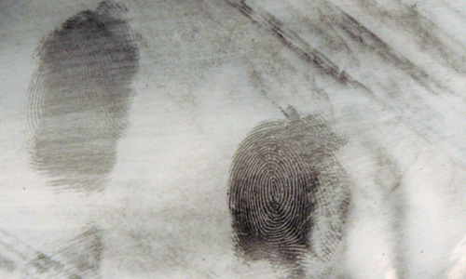
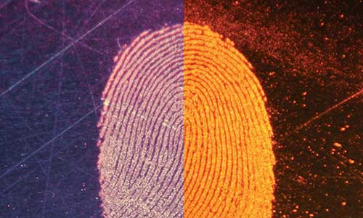
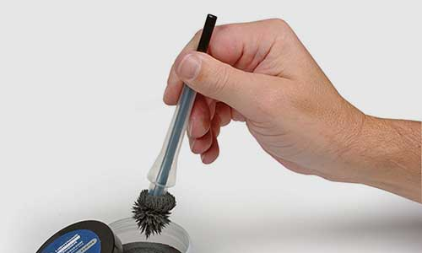
Development of fingerprints : powders
The powders are suitable for smooth, non-porous surfaces.
They work well mostly for fresh prints because the particles attach to the humid, sticky and greasy substances in the deposits.
Examples of powders : black powders, fluorescent powders and magnetic based powders.
The black power is manufactured from a variety of carbon-based powders with a binder.
The fluorescent powders are used where a print is difficult to distinguish from its surface.
The magnetic based powders consist of a mixture of iron particle and non magnetic flake particles (colorants).
Black powder
fluorescent powder
Magnetic based powder
https://www.safariland.com/fingerprint-powder-guide.html
Notes:
While the magnetic iron particles form the hairs of the magnetic brush, the non magnetic particles are carried along by those hairs but adhere to the deposits upon contact.
Advantage of using the magnetic based powder is to reduce the potential of destroying the trace of fingerprint by the brush wiping away the deposits.

Slide 13
Advantage of the magnetic based powders
Magnetic flake powders offer an advantage, as the excess powder on the surface can be easily removed with strong rare-earth magnet, often essentially enhancing print quality.
Flake characteristics can play an important role for the effectiveness of the removal.

Slide 14
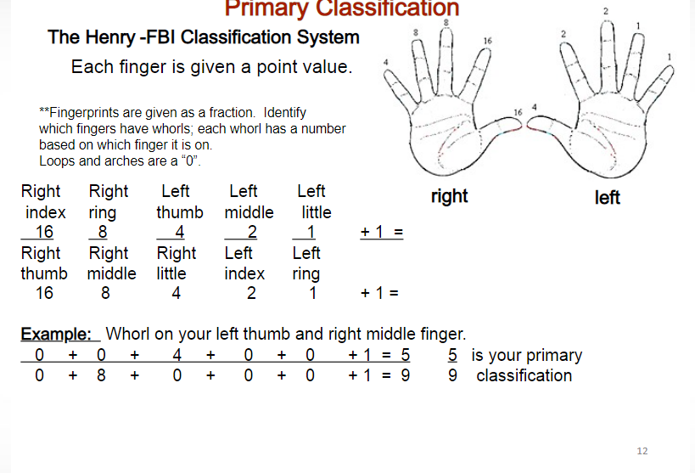
https://slideplayer.com/slide/4417906/

Slide 15
An example of international miscarriages of justice due to fingerprint evidence
Brandon Mayfield
Brandon Mayfield was a lawyer in the US State of Oregon who was identified as a participant in the Madrid bombing based on a fingerprint match by the FBI. The FBI Latent Print Unit processed a fingerprint collected in Madrid and reported a "100 percent positive" match against one of the 20 fingerprint candidates returned in a search response from their IAFIS— Integrated Automated Fingerprint Identification System. The FBI initially called it an "absolutely incontrovertible match".
Subsequently, however, Spanish National Police examiners suggested that the print did not match Mayfield and after two weeks, they were able to identify another man whom they claimed the fingerprint did belong to. The FBI acknowledged their error, and a court released Mayfield, who by that time had spent two weeks in custody.
In January 2006, a U.S. Justice Department report was released which criticized the FBI for sloppy work but exonerated them of some more serious allegations. The report found that the misidentification had been due to a misapplication of methodology by the examiners involved.
On 29 November 2006, the FBI agreed to pay Brandon Mayfield the sum of US$2 million in compensation.
Mayfield was an American-born convert to Islam and his wife was an Egyptian immigrant, but Wikipedia politely suggests that these “are not factors that should have affected fingerprint search technology.
http://criminalcpd.net.au/wp-content/uploads/2016/09/Fingerprints__An_Introduction_to_Dactyloscopy.pdf

Slide 16
References
1. P V D Haan, “Physics and fingerprints”, Contemporary Physics, 47:4, 209-230 (2006).
2. http://criminalcpd.net.au/wp-content/uploads/2016/09/Fingerprints__An_Introduction_to_Dactyloscopy.pdf
3. https://www.theregister.co.uk/2004/05/26/fbi_madrid_blunder/
4. https://www.safariland.com/fingerprint-powder-guide.html

